Slide 1


CUSTOMER SEGMENTATION USING ENSEMBLE LEARNING
PROJECT GUIDE: PRESENTED BY:
Mrs. D. Vamsi (P.h.d) Beeram Ravi Sankar - 20BQ1A0519
Assistant Professor Doredla Sethu Madhav - 20BQ1A0554
PROJECT CO-ORDINATOR: Chennupati Bhargava Lakshmi - 20BQ1A0536
Dr. N. Lakshmi Prasanna Yadagiri Yashwanth Kumar – 20BQ1A0502
Professor
Department of Computer Science
Vasireddy Venkatadri Institute of Technology
Padakakani Mandal, Namburu, Guntur-522508

Slide 2
INDEX
Abstract
Introduction
Literature review
Existing Methodology
Proposed Methodology
Problem Statement
Project Objectives
Software and Hardware Requirements
Implementation
Results
Results analysis
Conclusion
Future Enhancement
References

Slide 3
ABSTRACT
This project addresses the pivotal role of customer segmentation in refining marketing strategies and improving overall customer experience. Recognizing the limitations of traditional clustering methods in handling diverse and complex customer datasets, we propose a novel approach leveraging ensemble clustering.
The study aims to bridge the existing research gap by evaluating the effectiveness of ensemble clustering in comparison to conventional techniques. Our methodology involves the integration of multiple clustering algorithms and the assessment of segmentation quality using established metrics.
Results indicate that the ensemble approach outperforms traditional methods, showcasing enhanced accuracy and robustness in capturing nuanced customer segments. This research underscores the significance of ensemble clustering for businesses seeking more accurate and actionable insights into customer behaviour, thereby paving the way for refined marketing strategies and improved customer satisfaction.

Slide 4
INRTODUCTION
The field of customer segmentation stands at the forefront of strategic decision-making for businesses, aiming to tailor services and marketing strategies to diverse consumer needs. Traditional clustering methods often struggle to capture the intricate patterns present in heterogeneous customer datasets. This research addresses this challenge by proposing a novel approach – ensemble clustering. With the aim of enhancing the precision of customer segmentation, we delve into the unexplored terrain of leveraging multiple clustering algorithms collectively.
As businesses seek more nuanced insights into customer behaviour, the limitations of current methodologies become apparent, thus emphasizing the need for innovative approaches. This study not only aims to bridge existing research gaps but also to showcase the potential of ensemble clustering in deciphering complex customer dynamics. Through a careful examination of its effectiveness in comparison to traditional methods, we present a comprehensive analysis that contributes valuable insights into refining marketing strategies and optimizing customer satisfaction. In the subsequent sections, we delve into the methodology, results, and implications of employing ensemble clustering for customer segmentation.

Slide 5
LITERARTURE REVIEW
TITLE | AUTHOR NAME | METHODOLOGY | LIMITATION | PUBLISH YEAR | PRESENTED BY
Customer Segmentation Using K-Means Clustering Algorithm | Hemashree Kilari , Sailesh Edara , Guna Ratna Sai Yarra , Dileep Varma Gadhiraju | K-Means algorithm | Sensitive to noise and outliers Sensitive to data distribution | 2022 | 20BQ1A0519
Customer segmentation based on survival character. | Yun Chen , Guozheng Zhang , Dengfeng Hu , Chuan Fu | K-Means algorithm Survival analysis | Complexity overfitting | 2017 | 20BQ1A0519
Customer Behavior Analysis Using Data Mining Techniques | Patcharin Ponyiam Somjit Arch-int | Clustering , Association rule analysis | process velocity frequent item –set | 2018 | 20BQ1A0519
A Survey on Customer Segmentation using Machine Learning Algorithms to Find Prospective Clients | Vaidisha Mehta Ritvik Mehra Sourabh Singh Verma | K-Means algorithm Mean-Shift algorithm Agglomerative algorithm Divisive algorithm GaussianMixtureModel (GMM), DBSCAN | computationally expensive choice of the most suitable algorithm depends on the specific dataset | 2022 | 20BQ1A0519
New Methods of Customer Segmentation and Individual Credit Evaluation Based on Machine Learning. | Zhou Yuping Petra Jílková Chen Guanyu David Weisl | dynamic desensitization LOF (Local Outlier Factor) random forest method. gradient boosting decision scorecard model BP neuralnetworks | Data Privacy Concerns Bias and Fairness | 2019 | 20BQ1A0519

Slide 6
TITLE | AUTHOR NAME | METHODOLOGY | LIMITATIONS | PUBLISH YEAR | PRESENTEDBY
Comparative Analysis of Machine Learning Models for Customer Segmentation | Parmeshwara Joga, B. Harshini, and Rashmi Sahay | KMeans, DBSCAN, Agglomerative Clustering, PCA with KMeans | Data sets are small in size | 2022 | 20BQ1A0551
The practical pproach in Customers segmentation by Using the K-Means Algorithm | E.Y.L Nandapala , K.P.N Jayasena | K-means,Gap Statistic Method,Silhouette Method,Elbow Method | Data sets are small in size | 2020 | 20BQ1A0551
Customer Segmentation in XYZ Bank using K-Means and K-Medoids Clustering | Eka Miranda Evaristus Didik Madyatmadja Mediana Aryuni | RFM score,K-Means K-Medoids,Davies-Bouldin Index,Intra cluster (AWC) distance | Only two clustering algorithms are used | 2018 | 20BQ1A0551
Customer Segmentation using K-means Clustering | Tushar Kansal, SurajBahuguna , Vishal Singh, Tanupriya Choudhury | k-means,hierarchical clustering, DBSCAN clusteringMean shift Clustering,Silhouette Score | Based on only silhouette score performance is measured | 2018 | 20BQ1A0551
Incorporating K-means, Hierarchical Clustering and PCA in Customer Segmentation | Azad Abdulhafedh | K-means, Hierarchical Clustering,PCA,Silhouette average width, Davies-Bouldin Index, Dunn index | Reduced no of.dimesnsionalities from 17 to5 | 2021 | 20BQ1A0551

Slide 7
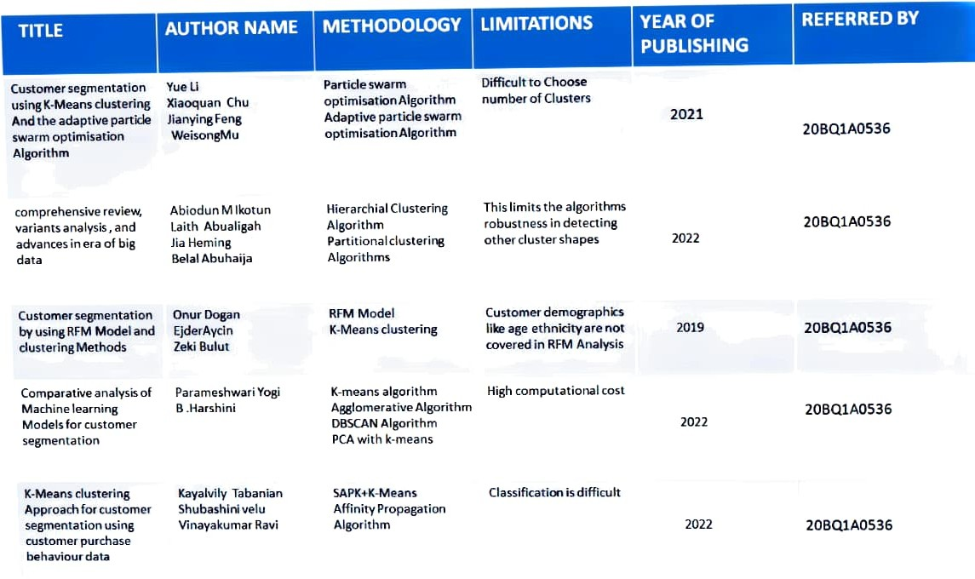

Slide 8
Title | Author Name | Methodology | Limitations | Published Year | Referred by
Customer Segmentation Using Clustering and Data Mining Techniques | Kishana R. Kashwan C. M. Velu | K-Means Clustering Hierarchical Clustering DBSCAN Algorithm | Assumption of Equal Cluster Sizes and Shapes | 2019 | 20BQ1A0502
Customers Segmentation in the Insurance Company (TIC) Dataset | Wafa Qadadeha Sherief Abdallahb | Probabilistic Models Dimensionality Reduction Techniques Time Series Analysis | Data Dimensionality Algorithm Sensitivity Cluster Validity | 2018 | 20BQ1A0502
Discovering Knowledge by Comparing Silhouettes Using K-Means Clustering for Customer Segmentation | Zeeshan Akbar Jun Liu Zahida Latif | Clustering Algorithm Selection Silhouette Analysis | Challenges in Determining the Optimal Number of Clusters | 2020 | 20BQ1A0502
Integration K-Means Clustering Method and Elbow Method For Identification of The Best Customer Profile Cluster | Syakur Khotimah Rochman Satoto | Data Preparation Feature Scaling Elbow Method | Unsuitable for Non-Globular Clusters | 2018 | 20BQ1A0502
New approach to customer segmentation based on changes in customer value | Monireh Hosseini Mostafa Shabani | Data mining approach | Data Availability and Quality | 2021 | 20BQ1A0502

Slide 9
EXISTING METHODOLOGY
There are many existing approaches for this customer segmentation using clustering techniques.
Each existing approach uses only single clustering algorithm like either k-means, agglomerative, dbscan, etc…
Outline of existing approach:
Data Collection
Data Pre Processing
Feature Scaling & Dimensionality Reduction
Model Implementation
Model Evaluation
Visualization
Limitations:
Using only single algorithm like k-means or agglomerative will give inappropriate results because it is sensitive to outliers and initial conditions, time complexity O(n^3). Similarly each algorithm has its own limitations.

Slide 10
PROPOSED METHODOLOGY
In this approach we have used ensemble clustering instead of single clustering technique, which is combination of results of 3 clustering algorithms with an ensemble method that gives high accurate results.
Outline of proposed methodology:
Data Collection
Data Engineering and data pre-processing
Feature Selection and Dimensionality Reduction
Individual Clustering
Ensemble Clustering
Model analysis
Visualization and profiling.
Advantages:
High accurate results
Easy to understand individual customer profiles

Slide 11
PROBLEM STATEMENT
In the realm of marketing, businesses face challenges in effectively segmenting their diverse customer base to tailor strategies. Traditional clustering methods may struggle to capture the complexity of customer behavior and preferences. The existing literature lacks comprehensive insights into leveraging ensemble clustering for more accurate and robust customer segmentation. This research aims to address this gap by investigating the effectiveness of ensemble clustering in enhancing the precision of customer segmentation, thereby providing valuable insights for refining marketing strategies and optimizing customer satisfaction.
PROJECT OBJECTIVES
• Compare existing algorithms with our new approach ensemble clustering.
• Find effective ways to enhance the customer retention techniques and customer
satisfaction.
• Evaluate and enhance stability and robustness of individual customer segments.

Slide 12
Software Requirements
Statistical Software : Python
Integrated Development Environment (IDE) : Jupyter Notebook
Technical infrastructure
Data Cleaning and Preprocessing Tools : NumPy and Pandas
Ensemble Clustering Libraries : “scikit-learn” Library
Visualization Tools : Matplotlib, Seaborn and mpl_toolkits.
Hardware Requirements
Processor: Intel Core i3 or equivalent processor.
RAM: 4GB minimum
Display: Standard computer monitor or display.

Slide 13
IMPLEMENTATION
Steps Followed :
Importing Libraries
Data Gathering and Data loading
Data Cleaning and feature Engineering
Data Preprocessing
Dimensionality Reduction
Clustering
Model Evaluation
Profiling

Slide 14
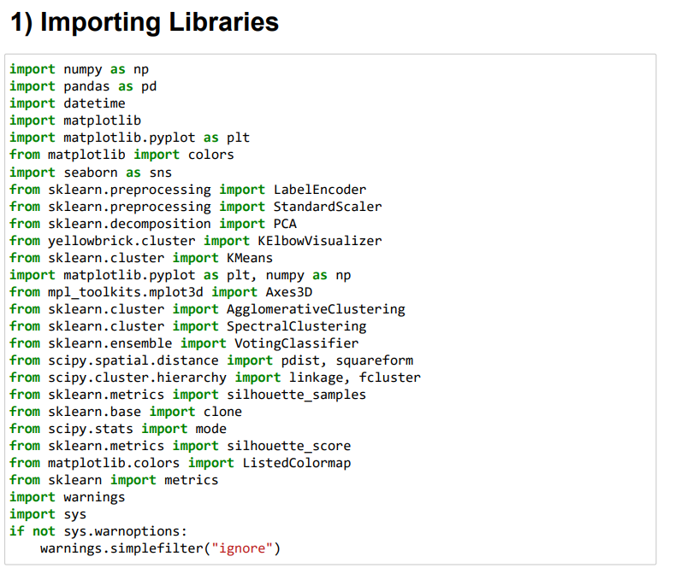
IMPORTING LIBRARIES
1. numPy: for numerical computing and array operations.
2. pandas: for data loading and manipulation.
3. matplotlib, seaborn, mpl_toolkits: for data visualization
4. sklearn: for clustering and data evaluation
5. scipy: for ensemble clustering
6. yellowbrick: for finding k-value
7. datetime: for feature engineering
8. warnings: to handle and control warnings

Slide 15
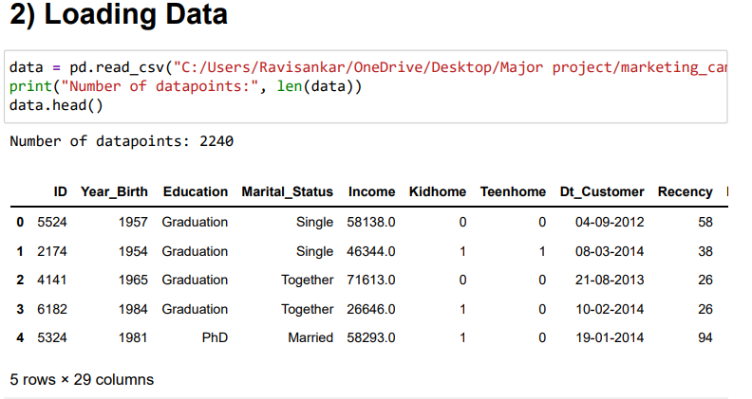
Data Gathering and Data loading
We have taken dataset from Kaggle open data source.
Source of our dataset: https://www.kaggle.com/code/karnikakapoor/customer-segmentation-clustering
We are using jupyter notebook platform.
Using pandas library we loaded our dataset.

Slide 16
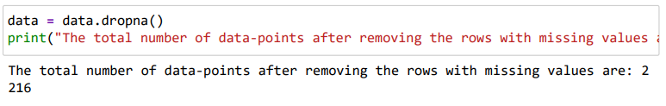
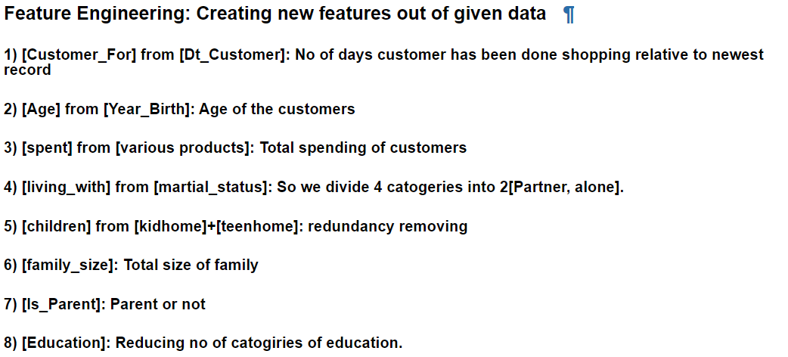
Data Cleaning and feature Engineering
In data cleaning we have removed the outliers using dropna method as we have only 2% of outliers
Feature engineering is creating new features from the existing features according to our requirements.

Slide 17
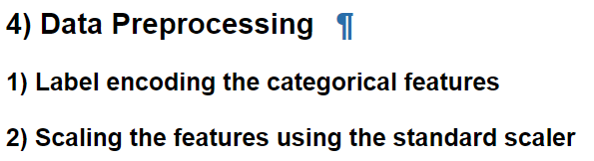
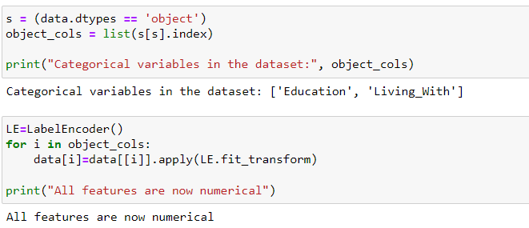
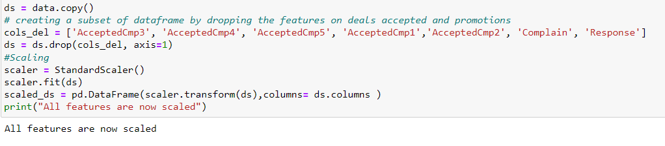
Data Preprocessing
Label encoding the categorical features: Converting the categorical attributes into numerical values.
Feature Scaling: Scaling all the features between 0 and 1[both included].

Slide 18
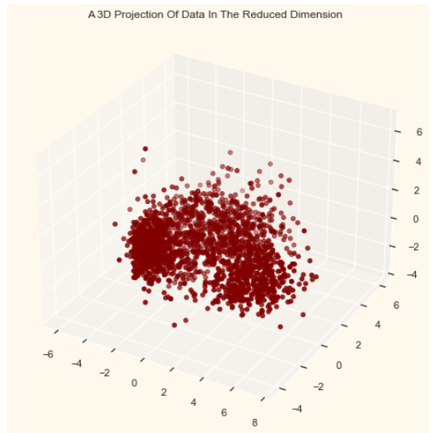
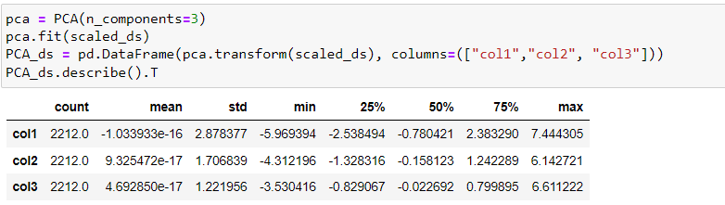
Dimensionality Reduction
In this step we have transformed the entire dataset into 3 dimensions using principal component analysis (PCA).

Slide 19
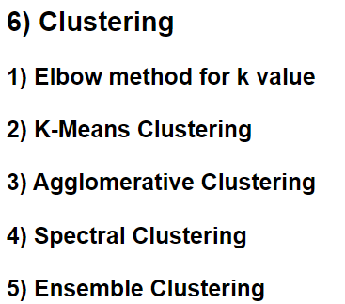
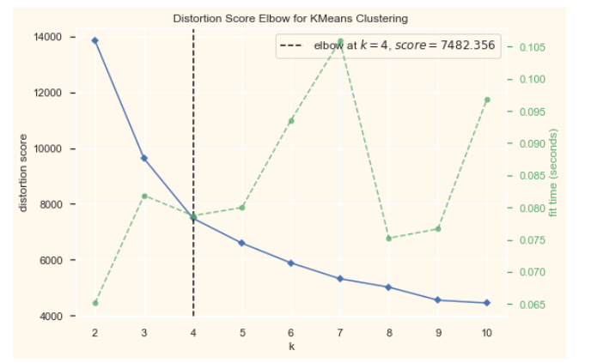

Clustering
Steps followed :
We used elbow method for finding k-value
kElbowVisualizer method from yellowbrick library

Slide 20
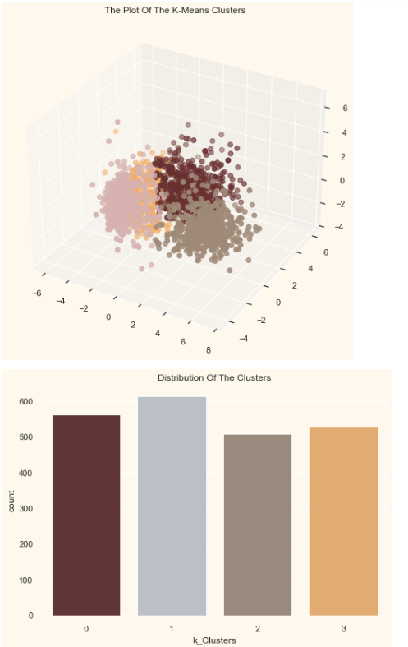
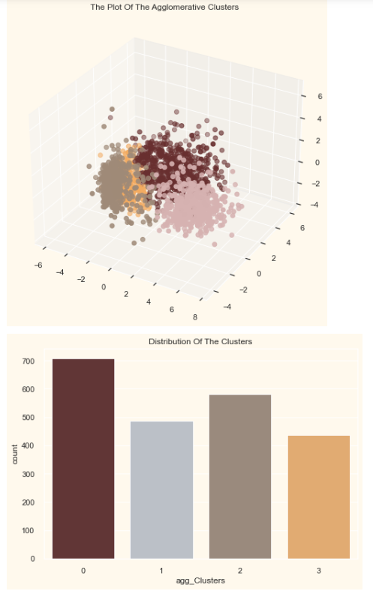
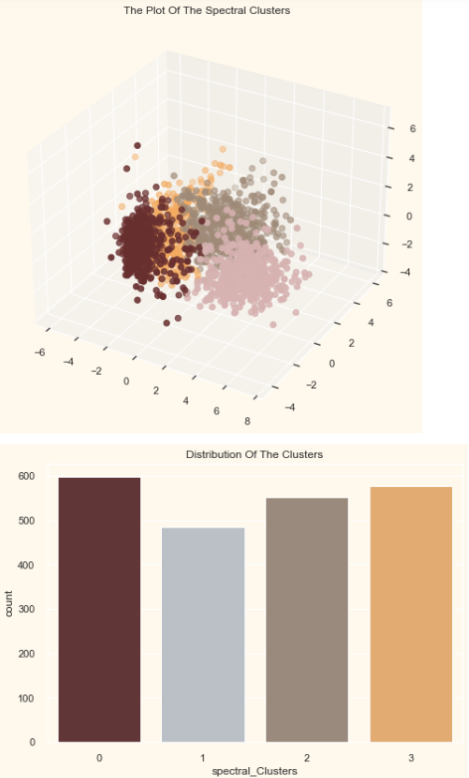
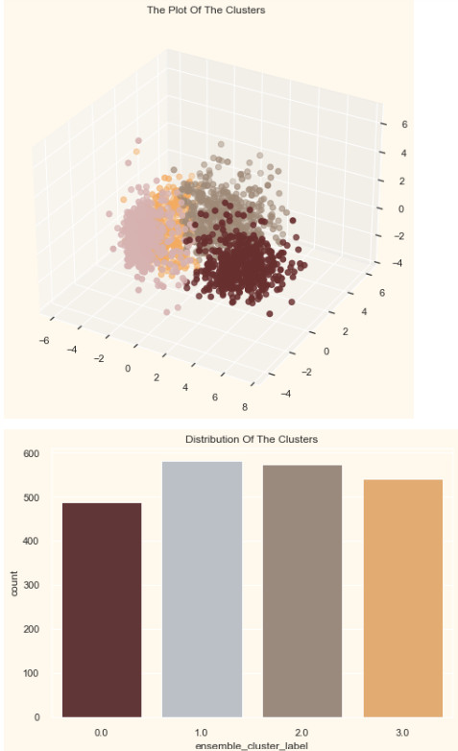
K-means agglomerative spectral ensemble

Slide 21
Model Evaluation
After performing individual clustering and ensemble clustering or consensus clustering these models are evaluated individually by using silhouette analysis.
Silhouette analysis gives a silhouette score to each clustering technique which lies between 0 and 1.
More the score means better the clustering results.

Slide 22
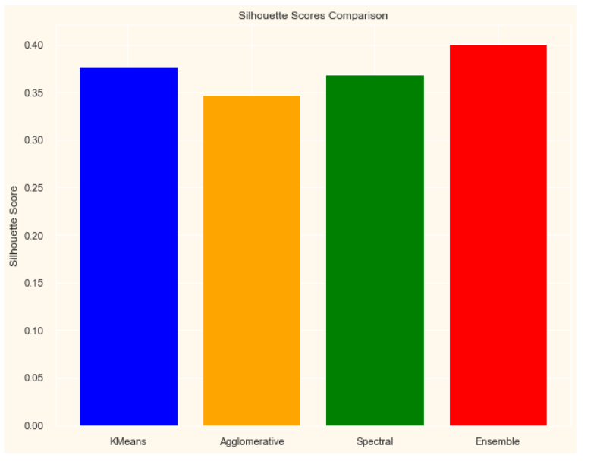

Results Ensemble outperforms all

Slide 23
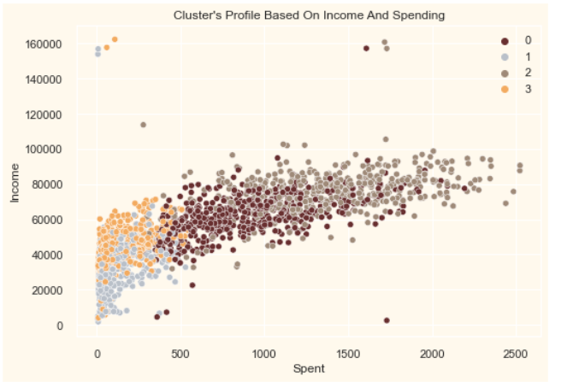
Each cluster group has different purchasing behaviours lets see it by drawing scatter plot between income vs spent

Slide 24
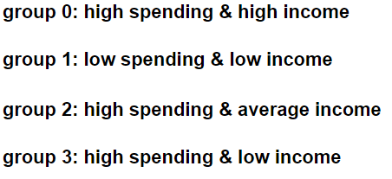
Results analysis
The results show that the ensemble clustering method achieved the highest silhouette score (0.4009), indicating better cluster cohesion and separation compared to individual base clustering algorithms (KMeans, Agglomerative, Spectral).
This suggests that combining multiple clustering techniques improved the overall clustering quality and effectiveness in capturing underlying patterns in the data.
After Understanding each cluster group with income vs spent these insights can be drawn

Slide 25
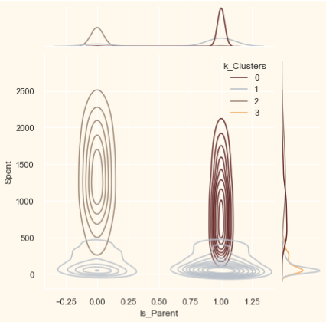
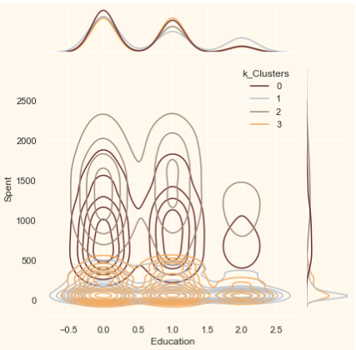
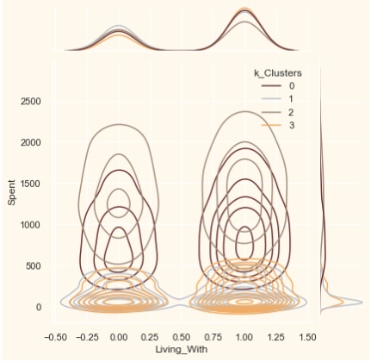
Profiling
Now that we have formed the clusters and looked at their purchasing habits. Let us see who all are there in these clusters
For that, we will be profiling the clusters formed and come to a conclusion about who is our star customer and who needs more attention from the retail store's marketing team.
To decide that I will be plotting some of the features that are indicative of the customer's personal traits in light of the cluster they are in.

Slide 26
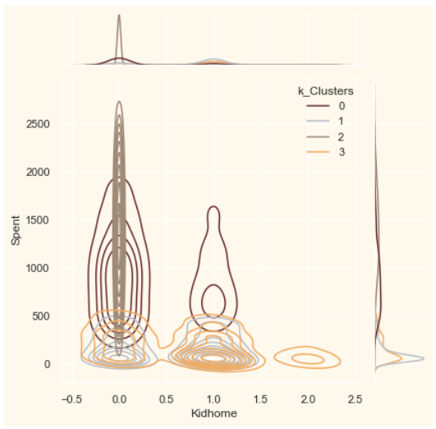
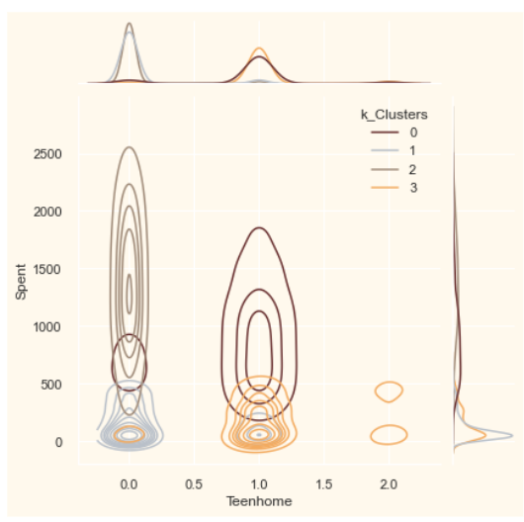
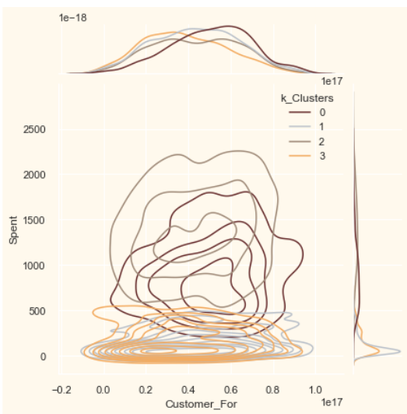
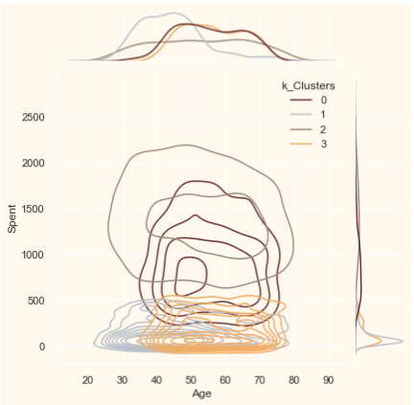
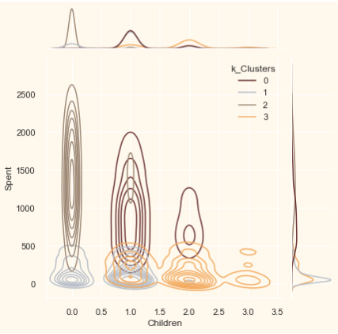
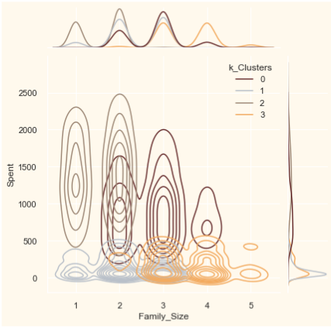

Slide 27
Cluster 0 | Cluster 1 | Cluster 2 | Cluster 3
Definitely not a parent | majority of people are parents | Definitely a parent | Definitely a parent
max are only 2 members in the family | max 3 members in the family | Max have 4 members in family and at least 2 | At max 5 members in family and at least 2
majority of couples over single persons | majority have one kid | most have a teenagers at home | Majority of them have teenagers at home
A high income group | Relatively younger | Relatively older | Relatively older

Slide 28
CONCLUSION
Our project employs a comprehensive approach to enhance customer segmentation by leveraging advanced data processing techniques, ensuring data consistency, employing innovative clustering strategies, conducting in-depth analysis, and utilizing impactful visualization methods, leading to more precise and actionable insights for optimizing marketing strategies and enhancing customer satisfaction. It empowers businesses to tailor marketing and services, ultimately improving customer satisfaction and competitiveness in today's dynamic market

Slide 29
Future Enhancement
Artificial intelligence for selecting the group of base algorithms
Continuous Monitoring of customer behaviour
Automated Analysis instead of manual analysis
Dynamic algorithms selection
Interactive Visualizations and dashboards

Slide 30
REFERENCES
Zhou Yuping, Petra Jílková, Chen Guanyu, David Weisl. New Methods of Customer Segmentation and Individual Credit Evaluation Based on Machine Learning. Atlantis Press, New Silk Road: Business Cooperation and Prospective of Economic Development (NSRBCPED 2019).
Hemashree Kilari , Sailesh Edara , Guna Ratna Sai Yarra , Dileep Varma Gadhiraju. Customer Segmentation using k-means Clustering. International Journal of Engineering Research & Technology (IJERT) .
Yun Chen , Guozheng Zhang , Dengfeng Hu , Chuan Fu. Customer segmentation based on survival character. Published online: July 20017 © Springer Science+Business Media, LLC 20017.
Patcharin Ponyiam, Somjit Arch-int , Khon Kaen University . Customer Behavior Analysis Using Data Mining Techniques . 2018 International Seminar on Application for Technology of Information and Communication (iSemantic).
Vaidisha Mehta, Ritvik Mehra, Sourabh Singh Verma. A Survey on Customer Segmentation using Machine Learning Algorithms to Find Prospective Clients. Conference Paper · September 2021. (PDF) A Survey on Customer Segmentation using Machine Learning Algorithms to Find Prospective Clients (researchgate.net)

Slide 31
Thankyou

